Slide 1


FYP Design Assessment Board
Development of an autonomous offroad navigation vehicle
1

Slide 2

Project Supervisor
Supervisor: Dr. BILAL MUHAMMAD KHAN
2

Slide 3



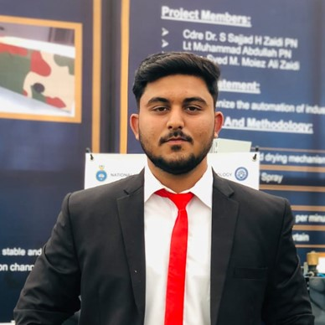

OUR TEAM
SHEHARYAR FAISAL
M.ABDULLAH
M.TAYYAB
M.MUBASHIR
KHANZADA
3

Slide 4
Project Sponsors
WOOTECH
CUAV – Pitched and obtained Sponsorship worth
Includes: Pixhawk, GPS
4

Slide 5

Problem Statement
Woot Tech, a leader in UAV systems for military and defense, aims to add unmanned ground, and surface vehicles (UGVs/USVs) as part of their fleet. The goal is to create a unified, human-in-the-loop mission system that is capable of interfacing with other autonomous vehicles.
5

Slide 6
Changes in Project Scope
1/8 Scale RC CAR to ATV
Increased Complexities
Mechanical: Steering, Body Development
Electrical: Vehicle Wiring, Additional System Constraints (Control)
Software: Simulation and autonomous capability
6

Slide 7
Complexities
Vehicle automation:
Accelerator Control: Converting from Grip Based to Servo Based
Brake Control: Converting from Hydraulic Based to Servo Based
Steering Control
7

Slide 8
System Implementation Flow Diagram
Simulation In Gazebo With PX4 SITL and ROS2
Instrumentation and Automation of ATV
RC Testing and Adding Autonomous Capabilities.
8

Slide 9
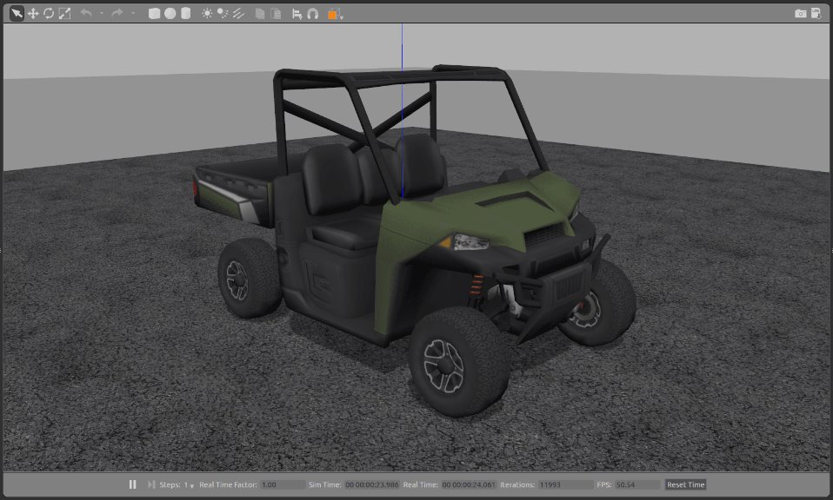
Simulation On Gazebo
Simulation in Gazebo World: Simulating realistic terrain.
PX4 SITL: Testing vehicle control and dynamics virtually before hardware.
ROS2 Nodes: Executing real-time trajectory commands.
9

Slide 10
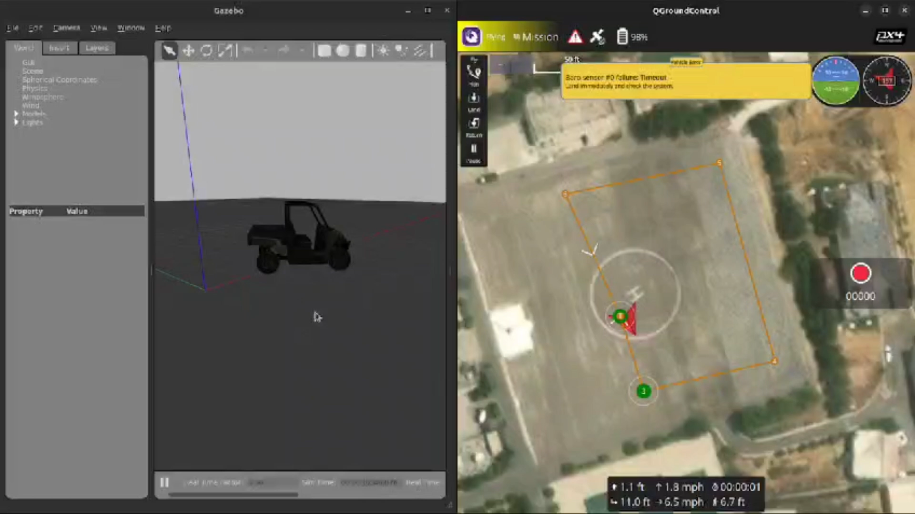

Slide 11
Simulation and Autonomous Development- 80% completed
Stage 1: Development of Simulation Model using ROS2 and PX4 interface: (Completed)
ROS2 doesn’t support compatibility with PX4 for Ackermann vehicle
Developed Script for custom vehicle compatibility using ROS2 (Ackermann Mode)
Stage 2: Development of Script for Autonomous Navigation of Vehicle (Completed)
ROS2 and PX4 integrated Script Developed that allows vehicle to perform point to point and even autonomous navigation capabilities
Stage 3: Testing on Vehicle (Incomplete)
11

Slide 12
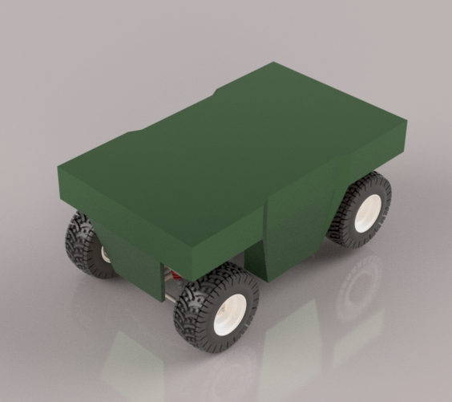
Mechanical Aspect 60% Completed
Design of Vehicle Body: CAD (Completed)
Vehicle Dimensions (5x2x2 ft)
Procurement of Material (Completed)
Welding and Testing (In Progress)
12

Slide 13
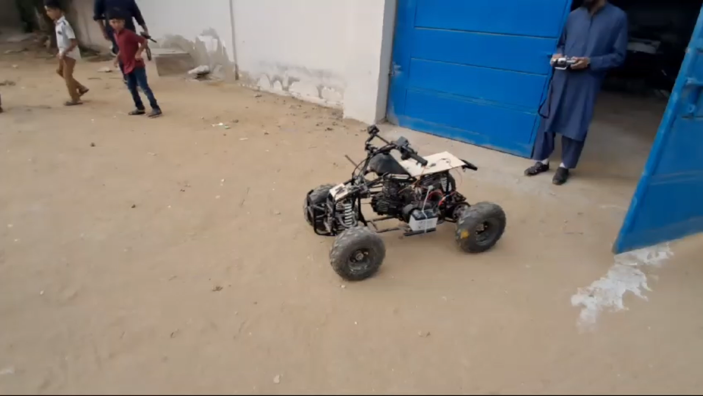
Steering Control
Test1:
Direct Testing of ATV Control using 80 Kg.cm servo
Results: On rough terrain, due to shooting torque requirement servo burnt
13

Slide 14
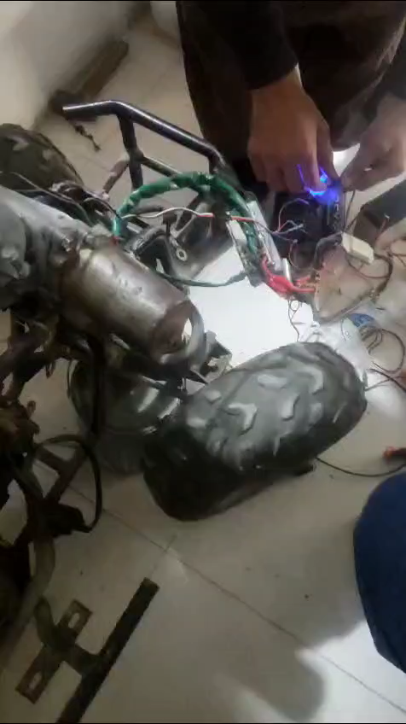
Steering Control
Converting a Manual Steering ATV to Electrical Powered (Power Steering)
Directly Controlling the steering using Servo resulted in it burning
Installed Power Steering which is control by Servo motor
14

Slide 15
System Architecture
GPS /SPEED SENSOR / IMUs
EMBEDED COMPUTER
RUNNIING ROS2
HIGH LEVEL PATH PLANNER
LIDAR
PIXHAWK Low Level Controller
DEPTH CAMERA
INPUT
OUTPUT
CONTROL
MOTORS /
Actuators
PAY LOAD
15

Slide 16
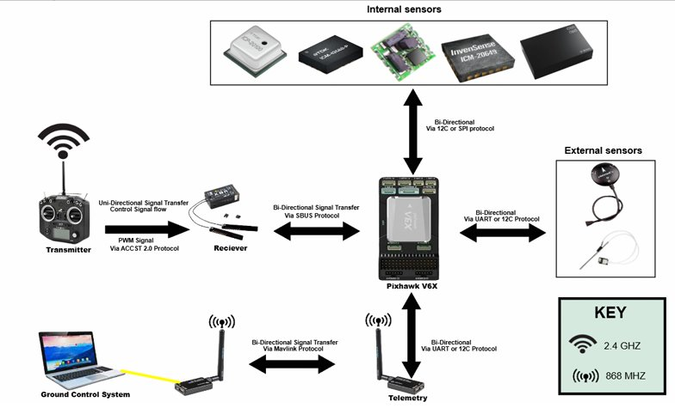
Communication Flow Diagram
16

Slide 17
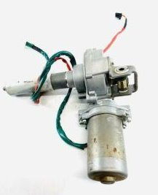
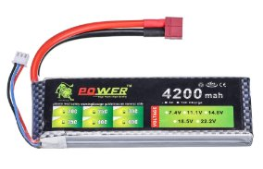
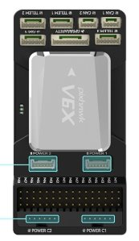
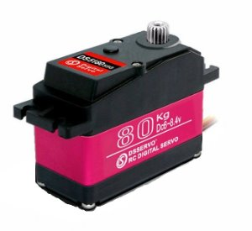
Steering Control Diagram
12V Lipo Battery
Provide torque to power steering
Servo rails o/p
17

Slide 18
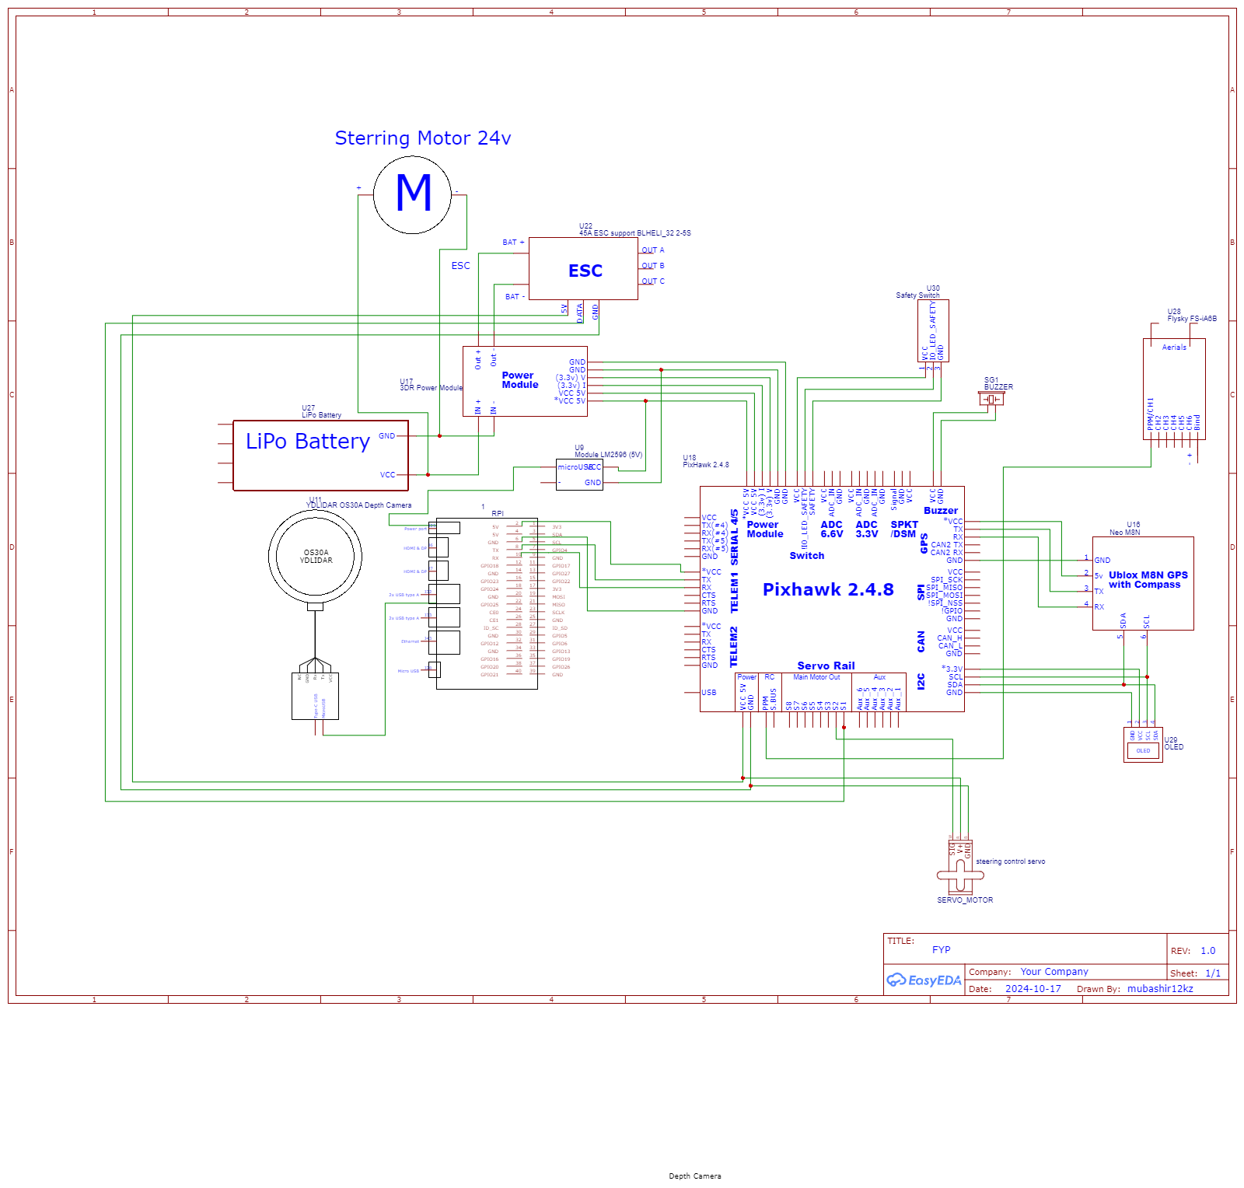
Wiring Diagram
18

Slide 19
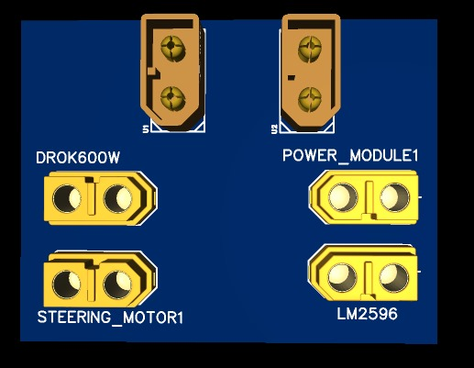
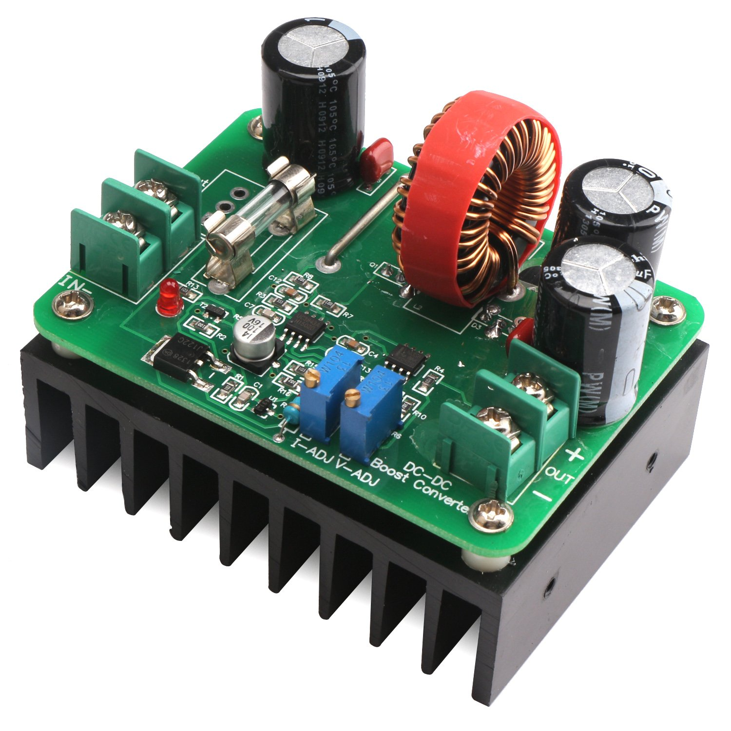
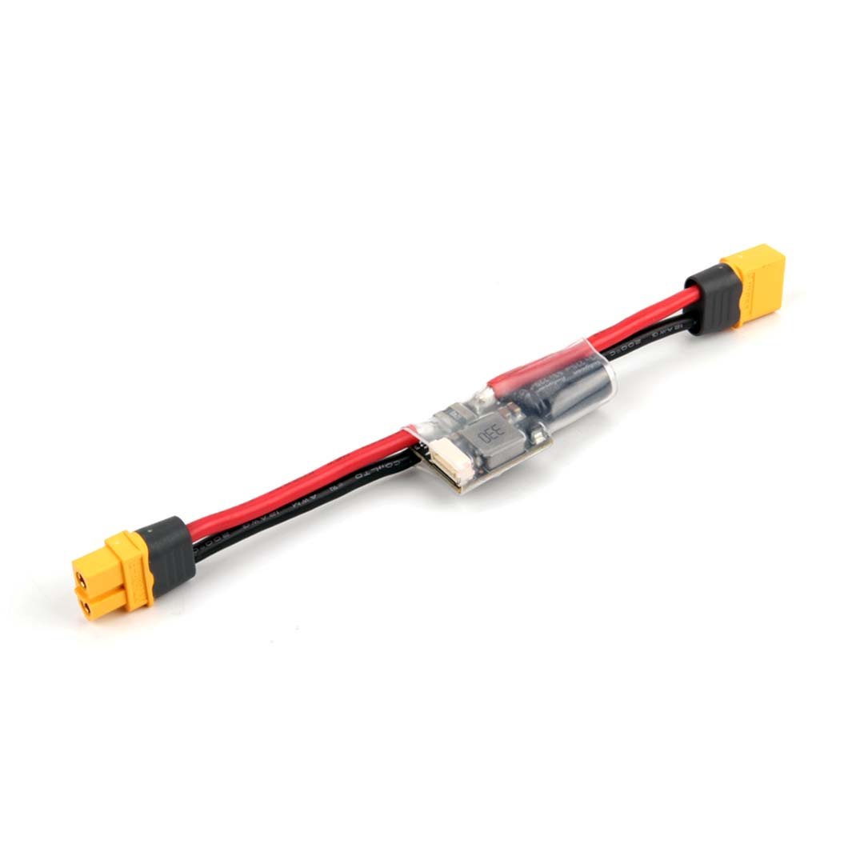
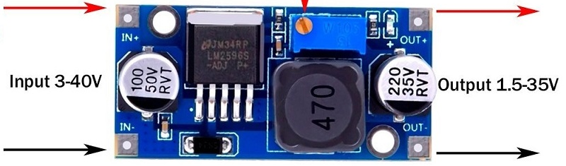
Power Distribution Board
x2
19

Slide 20
Electrical Aspect- 60 %completed
Wiring of the vehicle
Integrated Pixhawk controller with the vehicle
This involves integrating servos to ensure control of brakes and accelerator
Wiring the Power Steering
Integration of servo of steering and Pixhawk
Power division across the vehicle
20

Slide 21
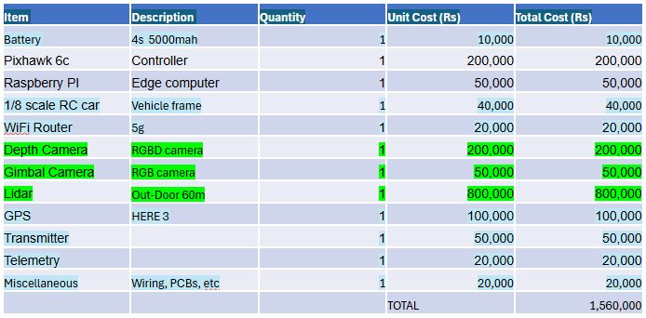
Tentative Budget
21

Slide 22

GANTT CHART
 | Nov-Jan |  |  |  | Jan-March |  |  |  | April onwards
 | Week 1-2 | Week 3-4 | Week 1-2 | Week 3-4 | Week 1-2 | Week 3-4 | Week 1-2 | Week 3-4 | Week 1-2 | Week 3-4 | Week 1-2 | Week 3-4
New Scope Decision
Procurement
Automation
Body and Welding
RC Testing
Autonomous Testing
Final Presentation
Paper Submission
To Do
22
Completed
In Progress
Milestones

Slide 23
Results obtained so far
Automation of Vehicle
Acceleration & Brake Control
Self Starting
Steering Control
Mechanical Body Design
CAD, Welding (In Progress)
Simulation Development
Point to Point Navigation – Software Done

Slide 24
Expected Final Deliverables
A Simulation Platform, along with point-to-point autonomous ATV capable of point-to-point offroad navigation, and Payload Attachment Capabilities.

Slide 25
Work Division
Sheharyar Faisal
Group coordinator
Simulation
Software modification
Muhammad Abdullah
Project Coordinator
Hardware and Software Automation
Control
Muhammad Tayyab
Software Coordinator
Rover Navigation
Simulation Model Setup
M. Mubashir Khanzada
Hardware Coordinator
Electrical Integration
Power distribution

Slide 26
References
Kalaria, Dvij et al. “WROOM: An Autonomous Driving Approach for Off-Road Navigation.” ArXiv abs/2404.08855 (2024): n. pag.
Li, Dianzhao & Auerbach, Paul & Okhrin, Ostap. (2024). Towards Autonomous Driving with Small-Scale Cars: A Survey of Recent Development.
A. Cortner, J. M. Conrad and N. A. BouSaba, "Autonomous all-terrain vehicle steering," 2012 Proceedings of IEEE Southeastcon, Orlando, FL, USA, 2012, pp. 1-5, doi: 10.1109/SECon.2012.6196932. keywords: {Microcontrollers;Heating;Steering systems;Pulse width modulation;Vehicles;Navigation},
Levinson, J., Montemerlo, M., & Thrun, S. (2011). Map-based precision vehicle localization in urban environments. Robotics: Science and Systems Conference (RSS).

Slide 27
THANK YOU : )

